Slide 1
Week 7 Update
AA 290 / AA 279D
11/5/2019

Slide 2
Contents
Implemented YA dynamics
Implemented ROE Dynamics
Questions about Maneuvers in ROE space
Currently stuck here → dVs are not propagating correctly in the Hill Frame
Moving forward
Best way to do this:
Inertial prop → HCW calculating of burns
ROE prop (lose non-secular effects?) → ROE calculating of burns → view in the HCW frame (this is where it currently breaks it seems)

Slide 3
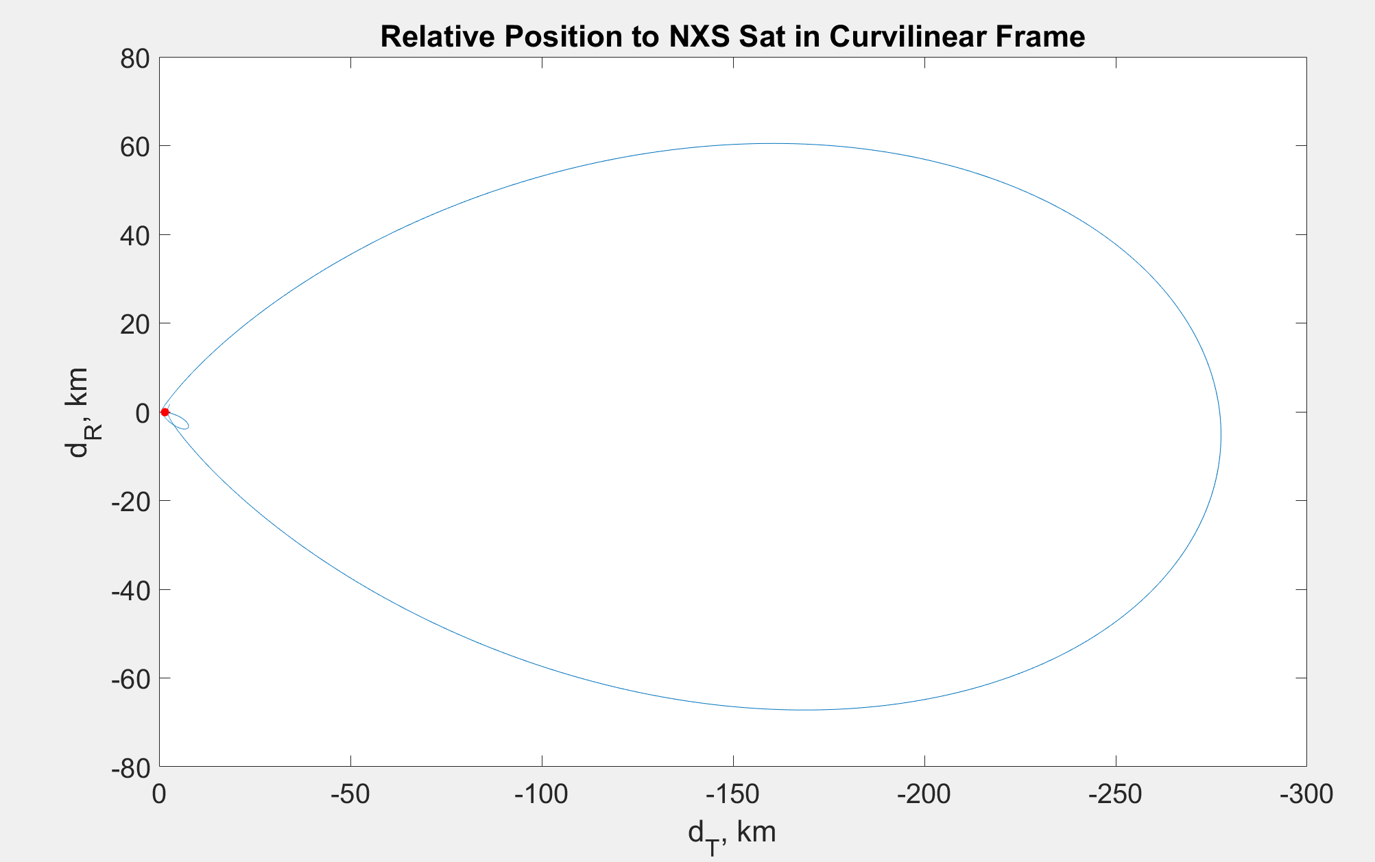
YA Dynamics Results
Propagating dynamics using YA state matrix results can be seen below
Used an example from a book to confirm results
Didn’t do any moding with YA equations

Slide 4
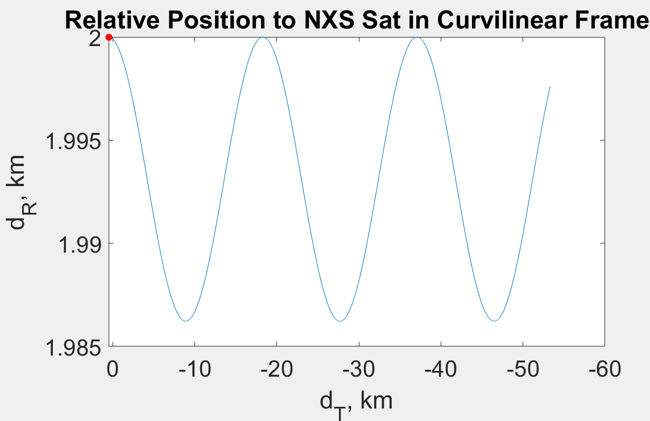
ROE Dynamics Results
Propagating dynamics using ROE state matrix gives correct results
Question: ROE dynamics remove short-period oscillations, for a rendezvous mission are these not important? Or do the ROEs cancel out the short-period oscillations between the two spacecrafts?

Slide 5
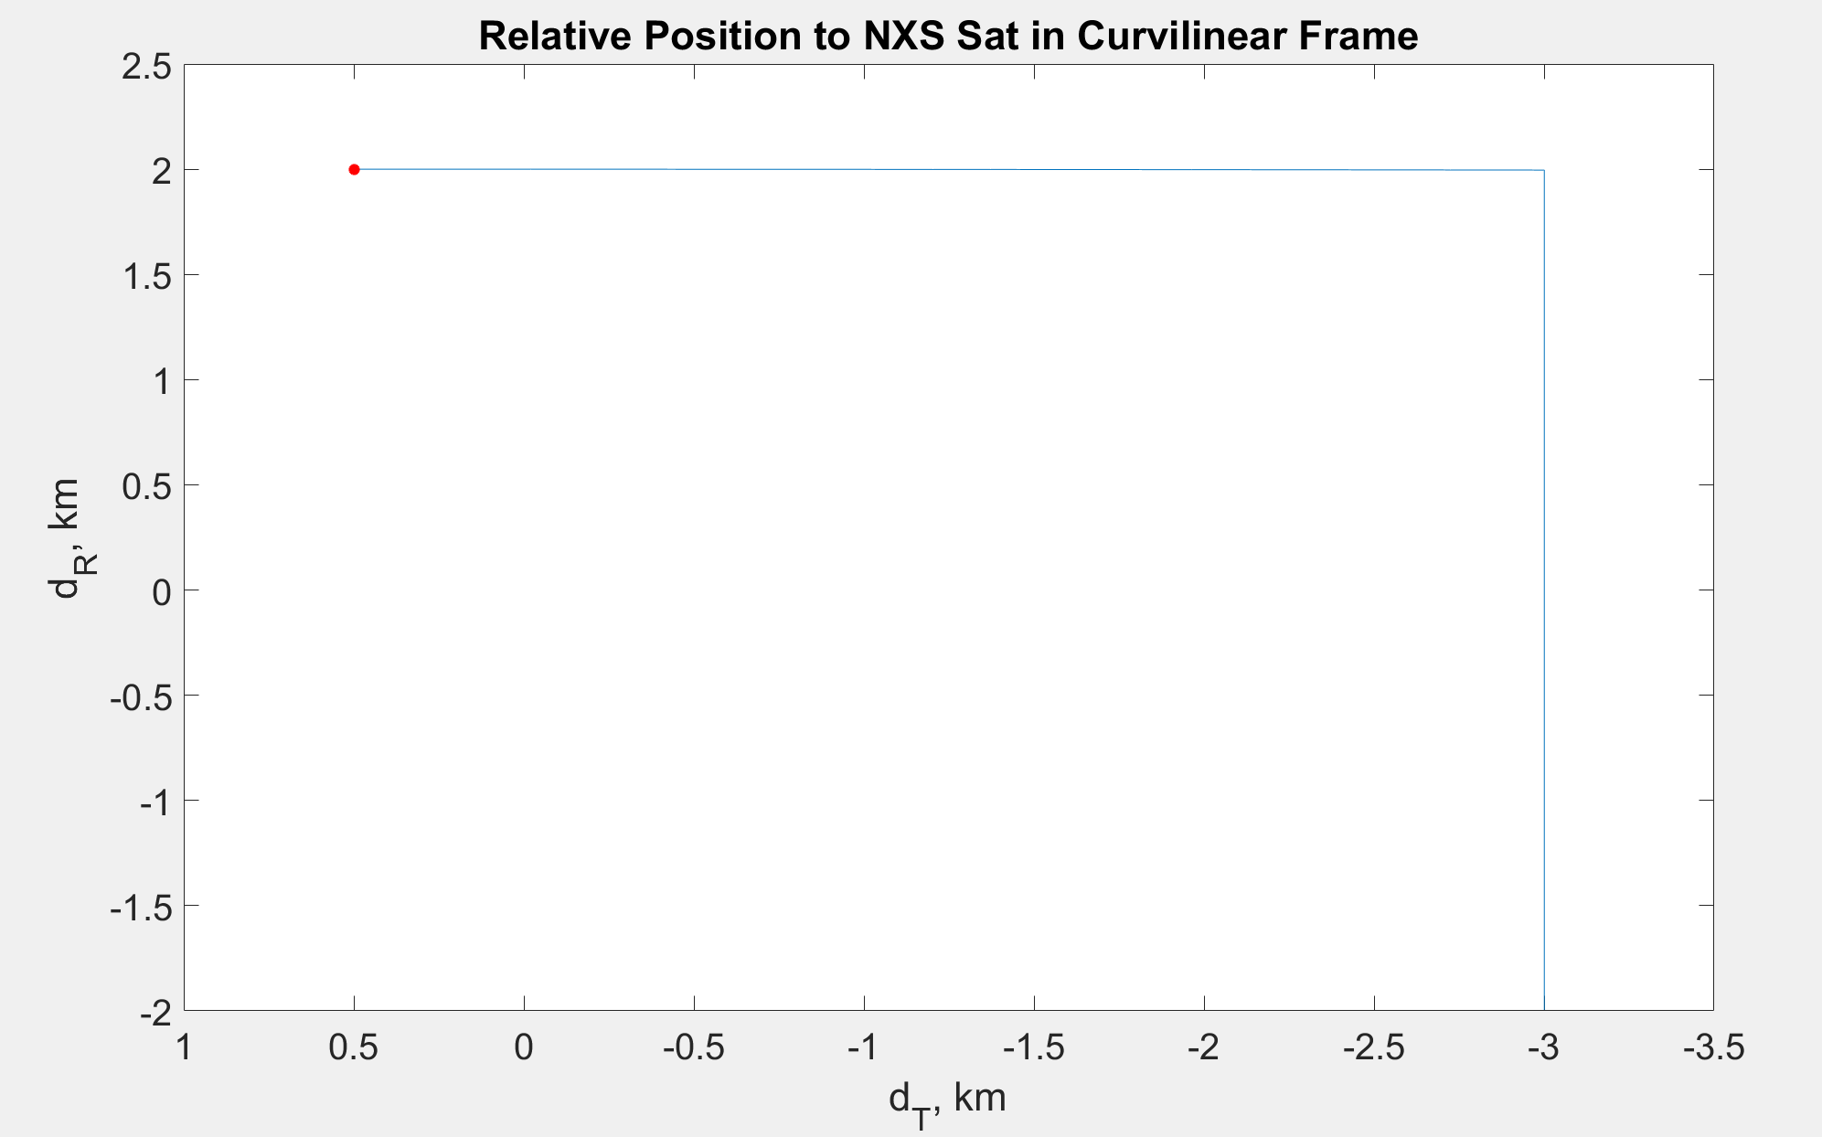
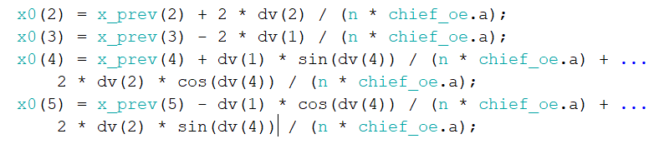
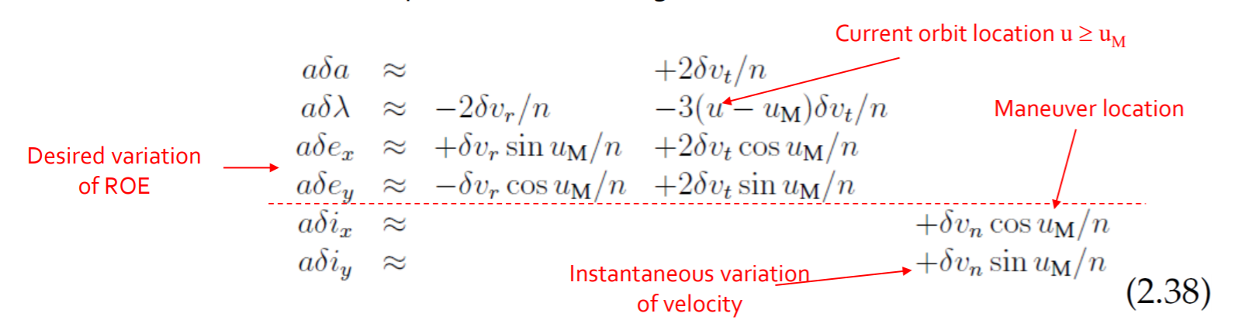
ROE Questions – Impulse Burns
Implementing impulse burns
Can calculate burns, but having trouble giving the correct impulse to the propagator
Figure below is trying to make the semi-major axes equal

Slide 6
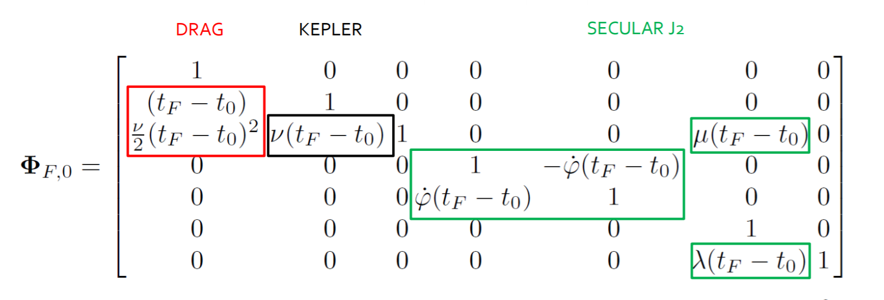
ROE Questions - Drag
Drag implementation
How do I find the adot term?
Is this found by numerically simulating the orbit in inertial frame and then plugging back in?
Do I have to keep track of the chief’s semi-major axis as it changes over time? Since semi-major axis affects the J2 effects it seems like I would have to propagate forward the chief’s orbital elements in order to keep an accurate simulation

Slide 7
Future Work Questions
What is the best way forward for rendezvous mission?
Inertial propagation and using HCW/YA equations to calculate burn directions and waypoint locations
ROE propagation and calculation of burns
Will have the most errors due to linearization to calculate burns
Might ignore short-period oscillations which could be important for rendezvous mission

Slide 8
Plan for next week
Get maneuvers working in either inertial or ROE propagation depending on previous slide answers
Get full mission planned out
Which maneuvers needs to get accomplished
Thinking that it will be one on-orbit maneuver to approach and then a series of either V-bar or R-bar hops
Further in the future:
Controller / Navigation Work

